Slide 1
Ethical Considerations
Feb 20 2025

Slide 2
Check in
What is one ethical consideration from the readings that resonated/stuck out to you?

Slide 3
Journey mapping activity goals
Gain greater appreciation for how high school student partners might experience our YPAR project
Drawing from the readings, identify potential ethical issues we might encounter and how we might navigate them

Slide 4
Journey mapping activity overview
Break into two groups
Take the perspective of a hypothetical high school student partner and walk through their YPAR journey
Empathize with their experience and 1) raise potential ethical issues that might arise and 2) identify how we might mitigate/address them (proactively or after the fact)
Use sticky notes, grouping, and upvoting to synthesize
Switch journeys
Debrief as a group

Slide 5
Agenda
[10 mins] Student 1 journey
[10 mins] Student 2 journey
[10 mins] Summarize the ethical issues/strategies (5 mins per student journey)
[15 mins] Debrief

Slide 6
Student 1
17 years old
Volunteered to participate
Topic = how heat affects mental health
Project = interviews with fellow students about how extreme heat—and its increasing frequency due to climate change—affects them emotionally
Student 2
18 years old
Participating as part of class
Topic = effects of heat on homelessness
Project = testing persuasive messages about how to stay cool in the heat

Slide 7
Parts of the research process: ethical issues and potential solutions
Select a research topic
Identify a problem to solve
Brainstorm potential solutions
Select an outcome/behavior to change and pose a research question
Develop a logic model / theory of change
Design survey, message experiment, or interview script to answer research question
Collect data from fellow students and potentially students in other class sections
Analyze and visualize the data
Interpret the results and draw conclusions
Summarize and present findings with/to one another and other stakeholders

Slide 8
Some considerations
Respect for agency & autonomy
Truth telling
Communication about sensitive topics
Boundaries?
Equity concerns
Privacy concerns
Ethics in information campaigns
choice of topics and segmentation
labeling and stigmatizing
risk messages, fear appeals, provocation
narratives and manipulation
appeals to responsibility and self-blame
appeals to social values
depriving
Ethics in YPAR
level of participation
power
consent
risk/benefit ratio
confidentiality and anonymity
remuneration and empowerment

Slide 9
Debrief
Which ethical issues seem most likely to arise?
Scenario 1
Scenario 2
Other scenarios we can imagine for this semester?
How will we know when an issue has arisen?
Scenario 1
Scenario 2
Other scenarios we can imagine for this semester?

Slide 10
Debrief
What should the role of young people in research look like?
“many countries believe it is a young person’s right to participate in research and use the United Nation Convention on the Rights of the Child (UNCRC) to support this belief. However, not all countries (e.g., the United States) have ratified this convention and so may differ in supporting youth inclusion in research.” What do you think about ths?
“However, it is important to listen to young people, and not force participation on youth. For example, some youth in Houghton’s (2015) research did not want to be part of the analysis phase as they considered it to be a ‘boring endeavor’ (p. 239). Thus, while it is generally recommended that youth should be included meaning- fully in as many aspects of the research project as is feasible, youth should be con- sulted with and listened to with regards to their level of participation and researchers should follow youth cues in determining when and how they will participate.” Should youth be able to opt out of participation because it is boring?
“As YPAR projects aim to include youth as equal participants, the consent process may be muddled as researchers move away from a protectionist viewpoint to working as cooperative partners (Balakrishnan & Cornforth, 2013; Khanlou & Peter, 2005).” How should we think about this?
“When research is being conducted in schools and supported by school-based authorities, youth may feel obligated to engage in research (Fargas-Malet et al., 2010). In addition, when gatekeepers, such as teachers, social workers or com- munity workers support recruitment, they may put forth particular young people who they deem as more ‘appropriate’. This, whether intentional or not, can be a tool to control the process and outcomes of the research (Horgan, 2017; Kennan et al., 2012).”
How should we think about confidentiality when students are part of the research team? Disclosures about e.g., mental health?

Slide 11
Debrief
What’s in it for the participants?
“public speaking and presenting, building their resumes, and other worthwhile activities as negotiated with participants.”
how should we balance opportunities for recognition and needs for confidentiality?

Slide 12
Plus/Delta
Plus
Delta

Slide 13
Break

Slide 14
Debrief engagement session #2
Plus
What went well?
What do we want to keep doing?
Delta
What didn’t work as well?
What might we change in the future?

Slide 15
Planning Engagement Session #3 (Feb 26)
Preparing for session 3 (facilitated by Penn students)
Originally focused on brainstorming problems and potential solutions
Community agreements
How many groups do we want (combine mental health and resources?)
Outline of planned engagement session #3
E.g., Activity to identify local initiatives and success stories with youth?
Drawing from Stepping Stones and other examples
Agenda
What materials do we have to prepare?

Slide 16
Planning Engagement Session #3 (Feb 26)
Within your small group teams:
What are your most important goals for the next session?
What is essential to accomplish with your group next week?
Discuss [10 minutes]/ share out [5 minutes]
Outline of planned engagement session #3 [20 minutes]
E.g., Activity to identify local initiatives and success stories with youth?
Drawing from Stepping Stones and other examples
See PSL from Netter
What materials do we have to prepare?
Rotate who drafts the agenda doc for the group/ comment on google docs?

Slide 17
Next Week
Wednesday: Engagement session #3 - meet at ~9.15am
Thursday: Role of theory in developing communication interventions

Slide 18
Transcribed engagement session flipcharts (Feb 19)

Slide 19
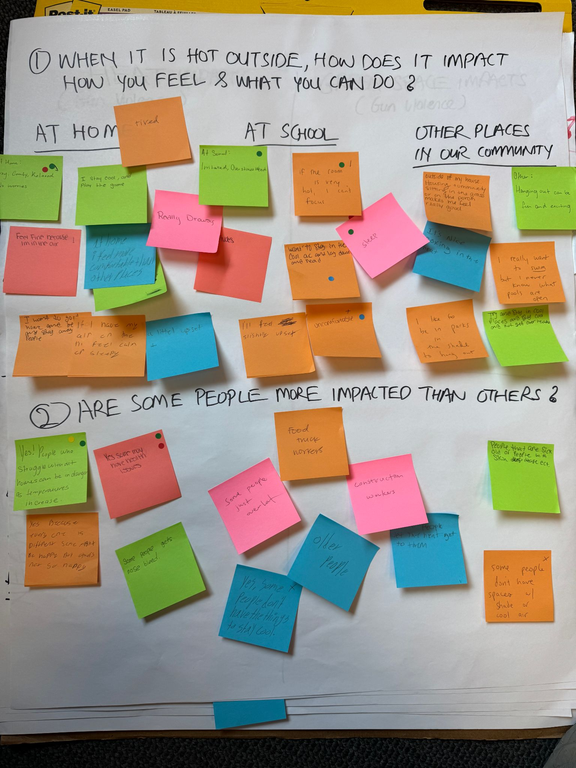
How does being hot outside impact you
At home:
Tired
Cozy, comfy, relaxed, no worries (+++)
I stay cool and play the gam
Feel fine because I’m in the air (con?) (+)
I want to go home and be cool and stay away from people
If I have my air on then I’ll feel calm or sleepy
A little upset (+)
Really drowsy
At school:
Irritated, overstimulated
Attitudes
I’ll feel slightly upset
Uncomfortable (++)
Want to stay in the cool ac and lay down and read (+)
If the room is very hot, I can’t focus (++)
Sleep (+)
Other places in the community:
OUtside of my house, housing community sitting in the grass or on the porch makes me feel really good
It’s nice boxing in the heat
I like to be in parks in the shade to hang out
Hanging out can be fun and exciting
I really want to swim but i never know what pools are open
Try and stay in cool places and stay cool and not geter over heated
Are some people more impacted?
Yes! People who struggle without homes can be in danger ass temperatures increase (++)
Yes. Because everyone is different. Some might be happy but others not so happy
Yes some may have health issues (++)
People that are sick, old, or people with skin disease etc.
Some people get nose bleeds
Some people just overheat
Yes, some people don’t have the things to stay cool (+)
Food truck workers
Construction workers
Older people
Some people let the heat get to them
Some people don’t have spaces with shade or cool air (+)

Slide 20
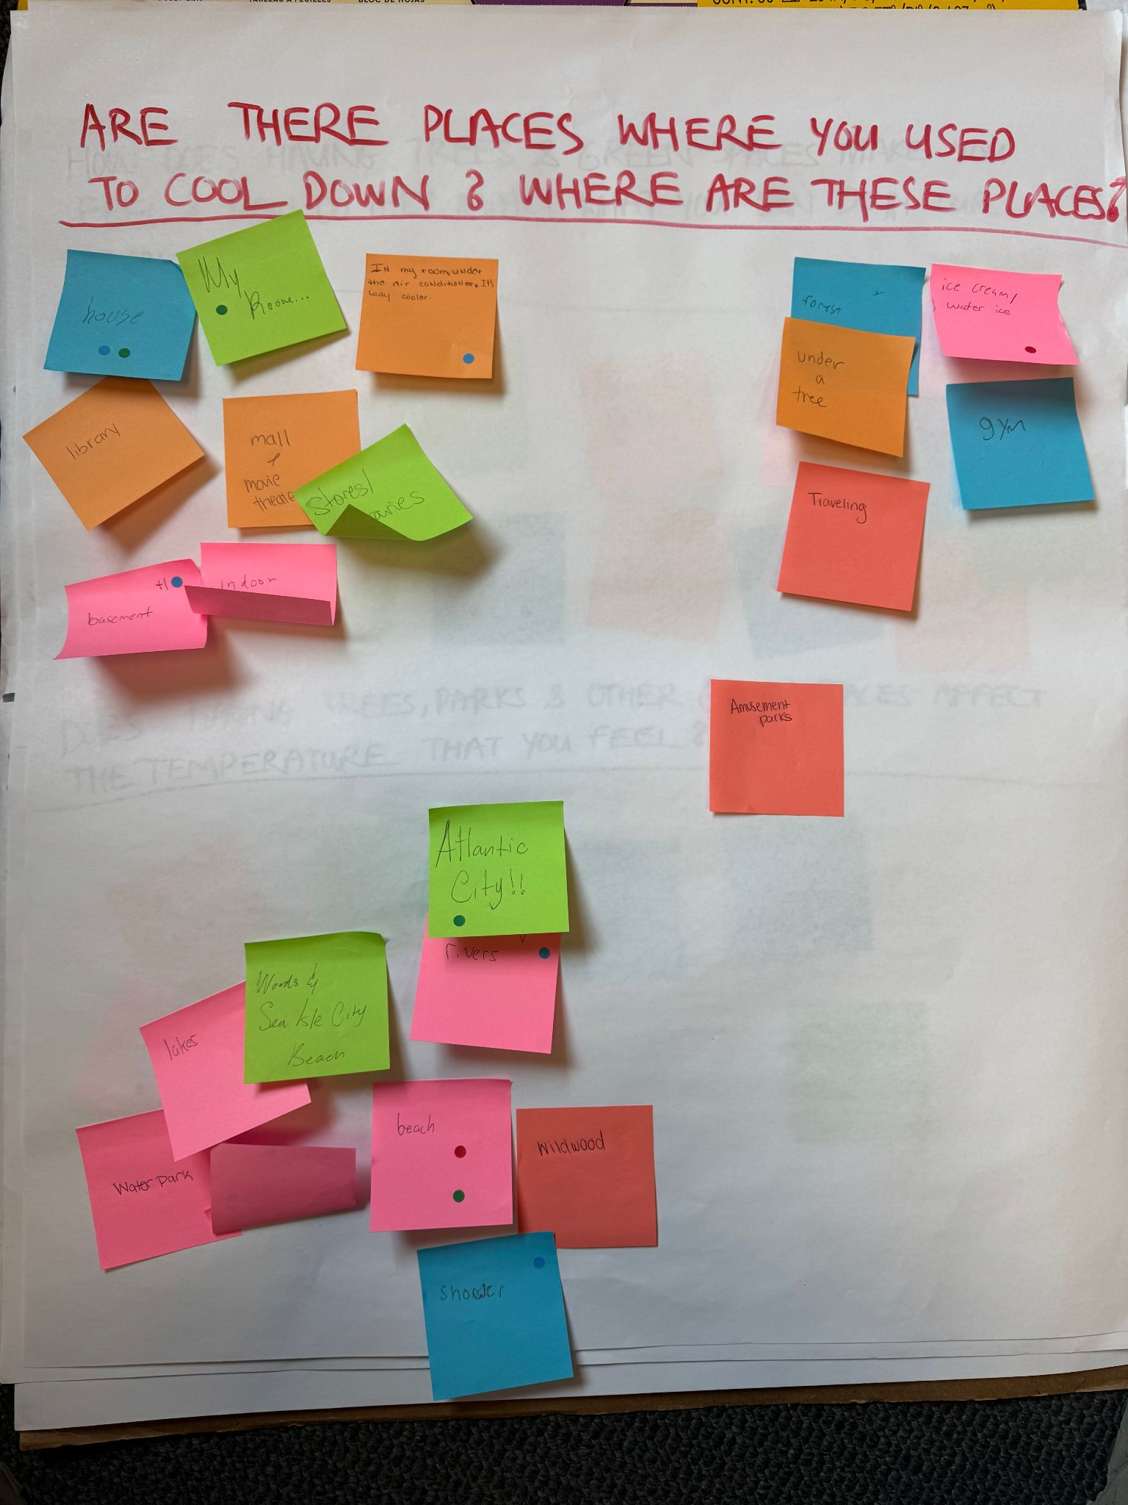
Places to cool down
House (++)
Library
Basement (++)
Mall and movie theater
My room/ In my room under the air conditioner, it’s way cooler (+)
Indoor skating rink
Stores and libraries
Forest (+)
Under a tree
Ice cream/water ice (+)
Traveling
Gym
Amusement parks
Rivers (++)
Atlantic City
Woods and Sea Isle City Beach
Wildwood
Beach (++)
Lakes (+)
Water park
Shower (+)
Pool (+++)

Slide 21
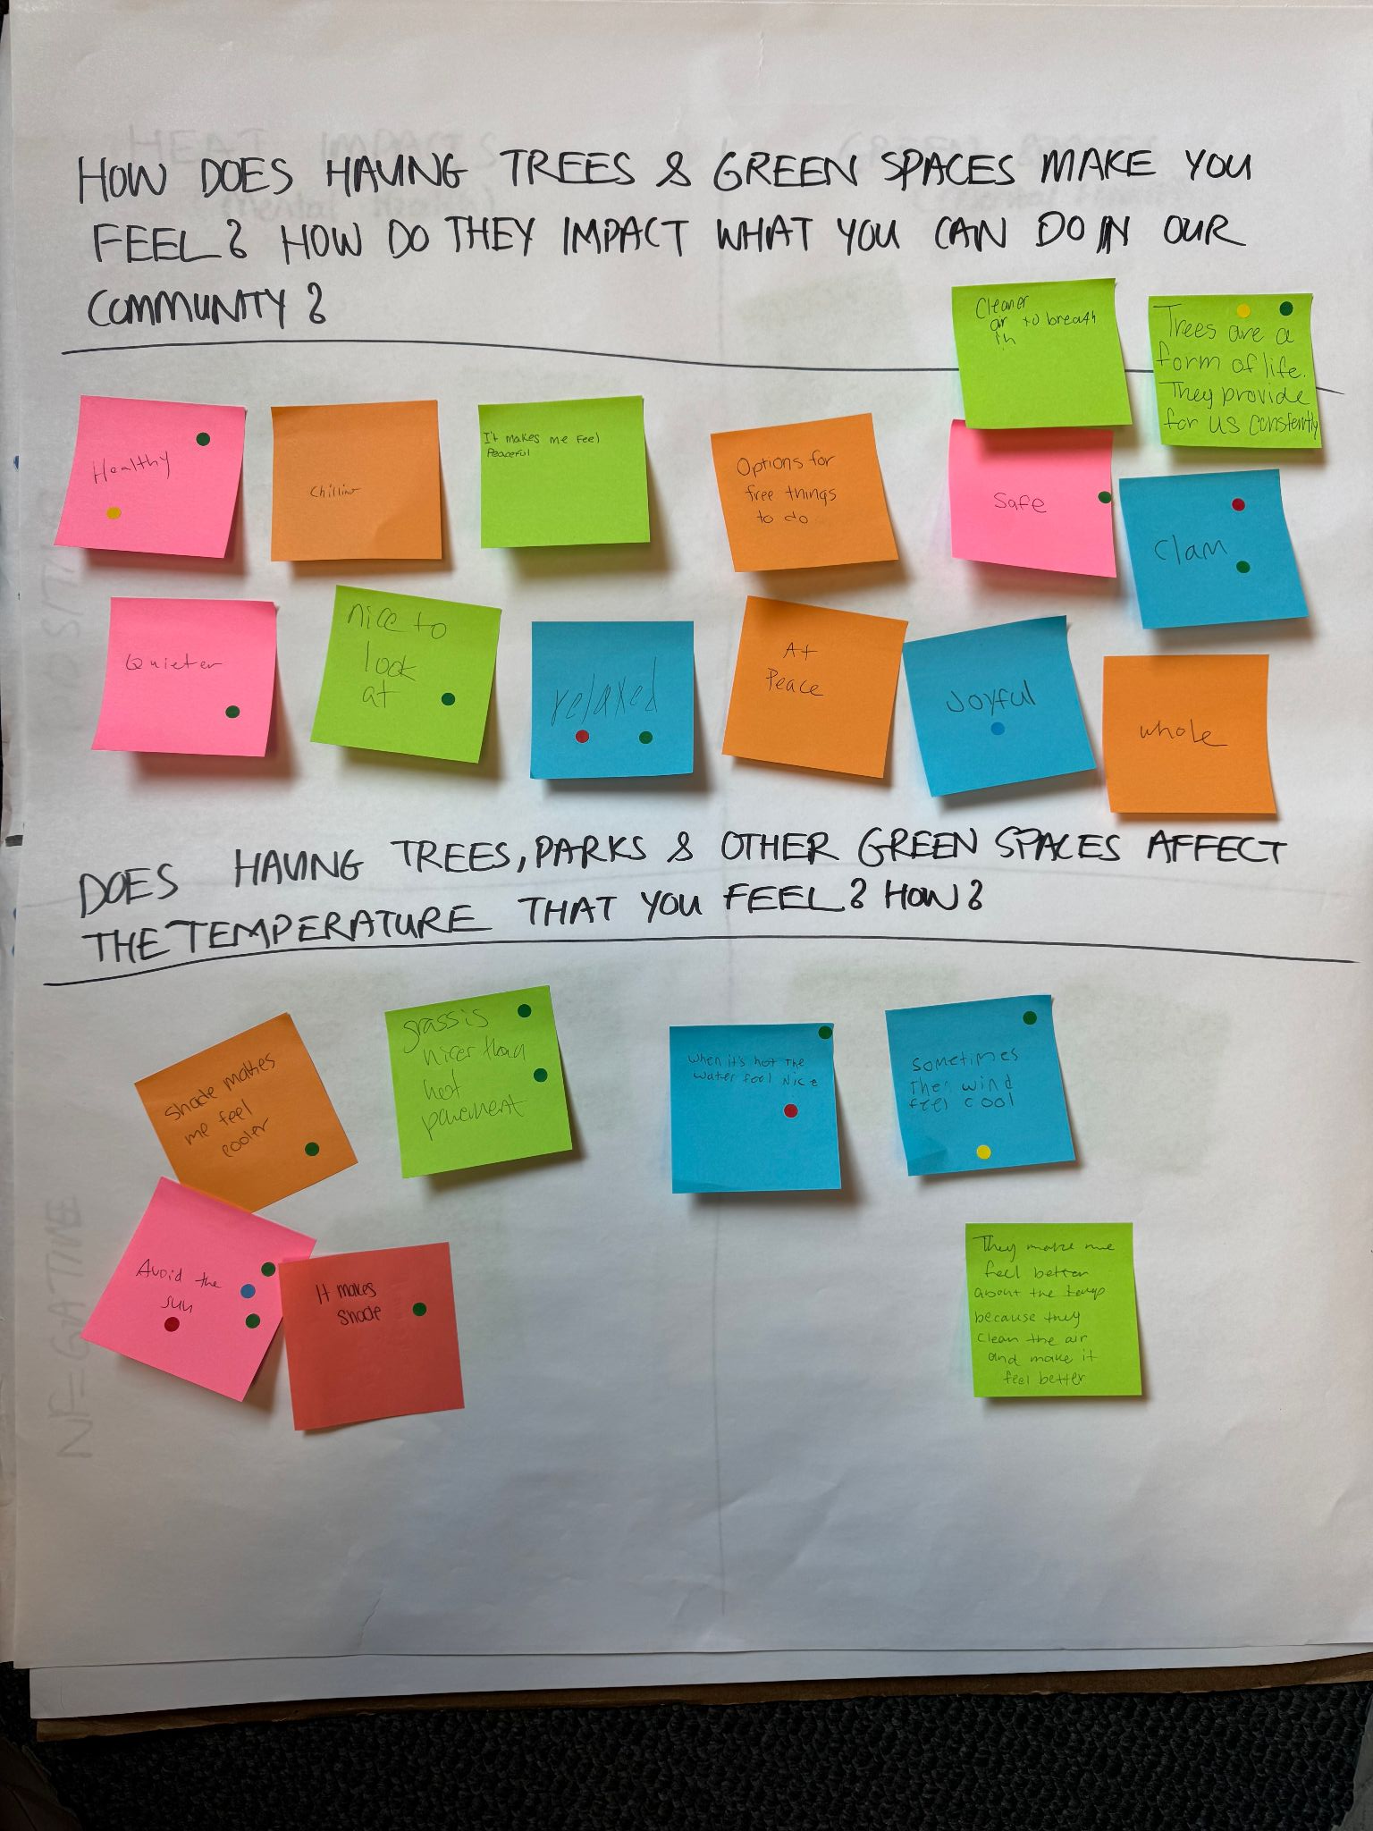
How having green spaces make you feel?
Healthy (++)
Quieter (+)
Chilling
Nice to look at (+)
It makes me feel peaceful/ At peace (+)
Relaxed (++)
Options for free things to do
Safe (+)
Joyful (+)
Cleaner air to breathe in
Trees are a form of life, they provide for us constantly (++)
Calm (++)
Whole
Affect the temperature you feel
Shade makes me feel cooler (+)
Avoid the sun (++++)
Grass is nicer than hot pavement (++)
It makes shade (+)
When it’s hot the water feels nice (++)
Sometimes the wind feels cool (++)
They make me feel beter about the temp because they clean the air and make it feel better

Slide 22
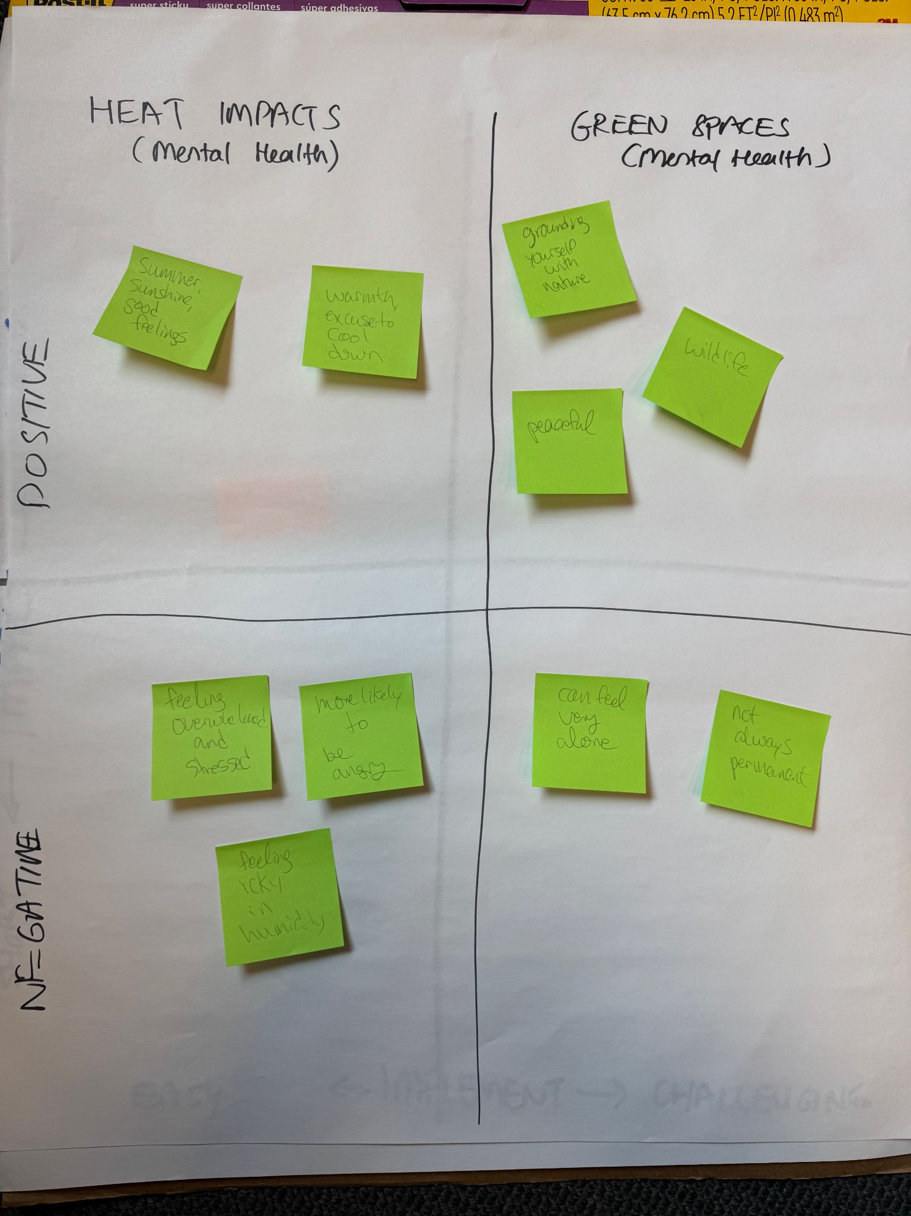
 | Heat impacts on mental health | Green space impacts on mental health
Positive impacts | Summer Sunshine good feelings Warmth, excuse to cool down | Grounding yourself with nature Peaceful Wildlife
Negative impacts | Feeling overwhelmed and stressed More likely to be angry Feeling icky in humidity | Can feel very alone Not always permanent - e.g., green space replaced by a building can feel like losing your home

Slide 23
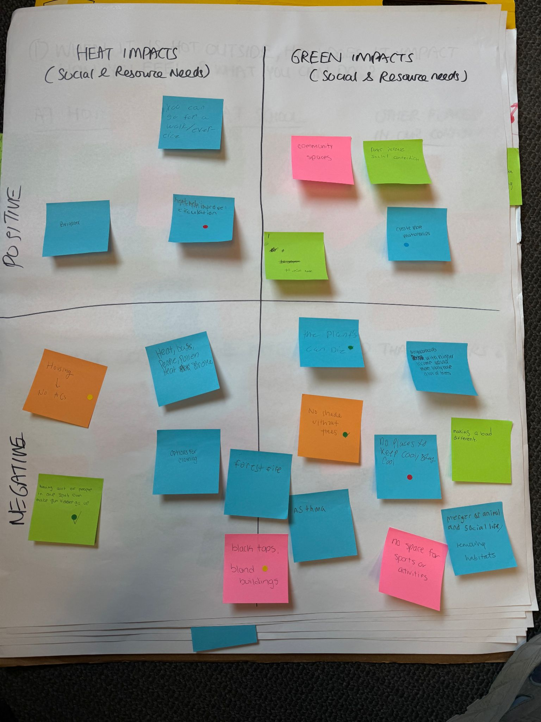
 | Heat impacts on social & resource needs | Green space impacts on social & resource needs
Positive impacts | Brighter You can go for a walk/ exercise Heat healps improve circulation (+) | Community spaces Create more relationships (+) Parks increase social connection To raise hope
Negative impacts | Options for clothing Heat, bags, people, pollen, heat stroke (+) Housing with no AC (+) Having a lot of peopl in one spt can make gun violence go up (++) | The plants can die (+) Neighborhoods with higher income would more likely have a lot of trees No shade without trees (+) Asthma No space for sports or activities No places to keep cool/ stay cool (+) Making a bad difference Merger of animal and social life, removing habitats Forest fire Black tops, bland buildings (+)

